Slide 1
Board of Health Meeting
May 21, 2015, 7– 8:30 p.m.
Commission Chambers, Courthouse Plaza East Building 115 N. 4th Street Manhattan, Kansas 66502

Slide 2
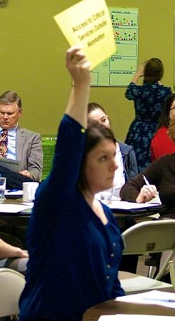
Contact Information
Brenda J. Nickel, MS, RN
Director & Local Health Officer
Riley County Health Department – 2030 Tecumseh Road, Manhattan, Kansas 66502
Office (785) 776-4779 Ext. 7639
bnickel@rileycountyks.gov
Jessica Fiscus, MPH
Community Health Educator
Riley County Health Department – 2030 Tecumseh Road, Manhattan, Kansas 66502
Office (785) 776-4779 Ext. 7612
jfiscus@rileycountyks.gov

Slide 3
Overview
Riley County Community Health Improvement Plan (RCCHIP): Overview of Presentation & Panelist Introduction
Overview of CCNA & RCCHIP Process
Public Comment on Draft RCCHIP: Survey Results
CHIP Implementation: Next Steps
Stories from the field: How the CHIP priorities are guiding change
Future Health Department Strategic Planning

Slide 4
Panelists
Brenda Nickel
Riley County Health Department
Jessica Fiscus
Riley County Health Department
Connie Satzler
Envisage Consulting
Chris McClead
Via Christi Hospital - Manhattan
Virginia Barnard
Public Health Advisory Council
K-State Research and Extension

Slide 5
Process

Slide 6
Process Timeline

Slide 7
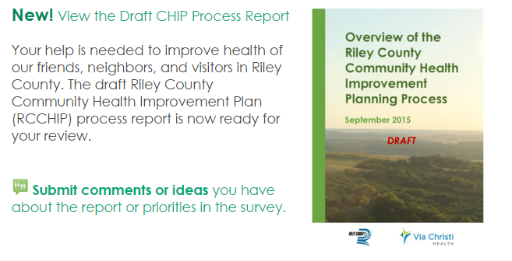
Public Comment Timeline
September 25th: Public comment response survey created and posted online with the report
October 1st: Promoted via mass email communications
October 1st – 23rd: Promoted on Facebook
October 23rd: Public comment deadline
October 25th: Online survey closed

Slide 8
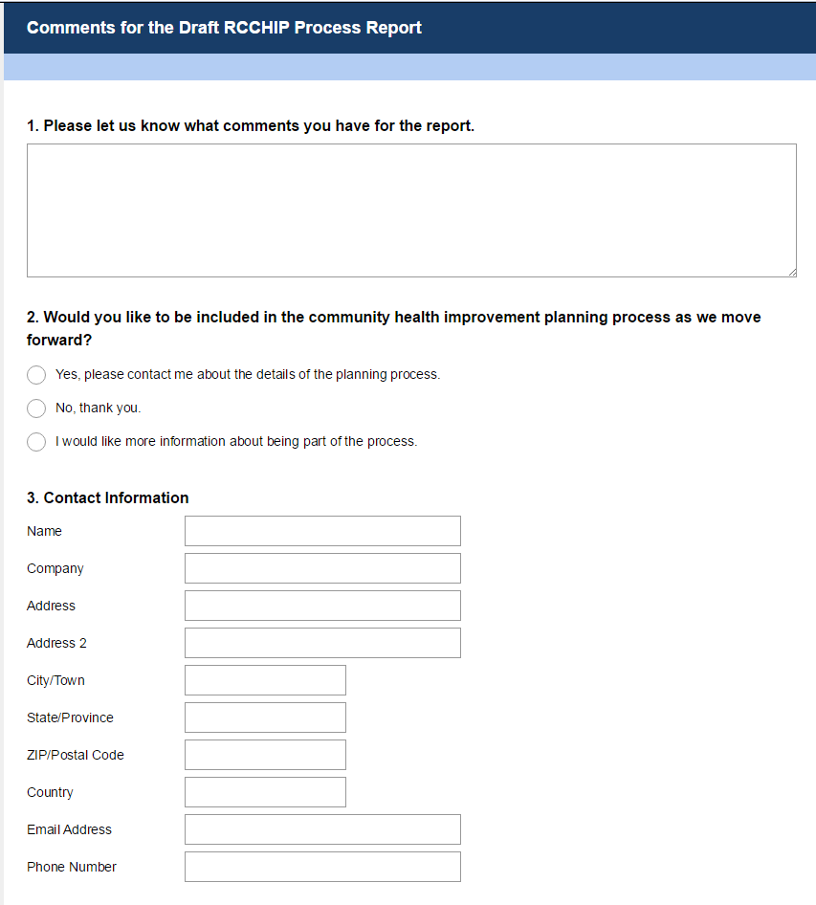
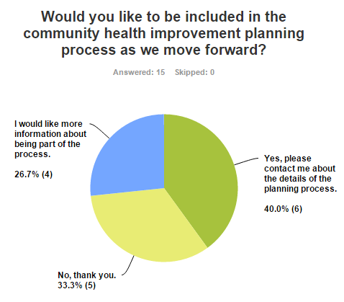
Public Comment Statistics
Facebook reach of 4,315, 105 post clicks , and 76 likes, shares, and comments
15 responses received from public comment survey
Moving forward, two-thirds of respondents (10 out of 15) either wanted to help or wanted more information

Slide 9
Public Comment Highlights
Summary of public comments by topic addressed. Some comments were counted in more than one of the below categories.
8 positive comments
5 comments related to mental health
2 of those addressed mental health & corrections
2 comments related to substance abuse or binge drinking
2 comments related to report formatting
1 offer to assist in a specific area
1 comment with multiple questions/suggestions
1 comment on women’s health issues
1 comment on healthy nutrition/healthy restaurants

Slide 10
Sample Public Comments
“I think all of the main issues have been recognized here….This was put together very well.”
“I liked seeing the quotes from participants on the topics. I found them very insightful.”
“I found the use of the soft colors in some of the bulleted lists quite hard to read.”
“…I would like to see a graphic that summarizes the ‘next steps’ on the top 3 priorities so someone could glance at one page and know what the plan was going to do and the general timeframe….”
“I didn't grasp where health issues specifically relating to women were addressed (health screenings, birth control, STD prevention/treatment, unplanned pregnancy, etc.)…”

Slide 11
Sample Public Comments
“I agree there is a huge mental health problem in the nation, not just Riley County. Our jails have unfortunately become the mental health center and residents are released with minimal supply of medication and no appointment for follow-up. The resident is caught not able to function and thus are back in the hospital ERs and jails as a means to ‘stabilize’ their health. However, throwing money at a broken system without a clear defined plan is not the solution….”
“…I sincerely hope that identifying mental health as an extremely important issue in Riley County is only the first step, and that actual resources will be created to insure help for those who are ill.”

Slide 12
Moving Forward
MPH Student
Orientation - Monday, October 26
Present Information - December
Flint Hills Wellness Coalition
Heartland Healthy Neighborhood Leadership Meeting - November
Restructure, Resolution, and Bylaws - December
CHIP
Develop SMART Goals and Objectives
Develop Monitoring Plan
Research on Top 3 Priority Areas - November 16

